Slide 1
Python Conditional Statements
S1 MCA

Slide 2
Conditional Statements
Conditional statements in Python allow for different blocks of code to be executed based on whether certain conditions are true or false. These statements are crucial for controlling the flow of a program and enabling decision-making.
if
if-else
if-elif-else (or if-elif ladder)

Slide 3
If Statement
A Python if statement is a fundamental control flow statement used for decision-making. It allows a specific block of code to be executed only if a given condition evaluates to True.
Syntax:
if condition:
# Code to execute if the condition is True
statement_1
statement_2
# ...
age = 18 if age >= 18: print("You are eligible to vote.")

Slide 4
Elif
The elif keyword is Python's way of saying "if the previous conditions were not true, then try this condition".
a = 33 b = 33 if b > a: print("b is greater than a") elif a == b: print("a and b are equal")
→ In this example a is equal to b, so the first condition is not true, but the elif condition is true, so we print to screen that "a and b are equal".

Slide 5
else
The else keyword catches anything which isn't caught by the preceding conditions.
a = 200 b = 33 if b > a: print("b is greater than a") elif a == b: print("a and b are equal") else: print("a is greater than b")
In this example a is greater than b, so the first condition is not true, also the elif condition is not true, so we go to the else condition and print to screen that "a is greater than b".

Slide 6
You can also have an else without the elif
a = 200 b = 33 if b > a: print("b is greater than a") else: print("b is not greater than a")
Short Hand If
if a > b: print("a is greater than b")

Slide 7
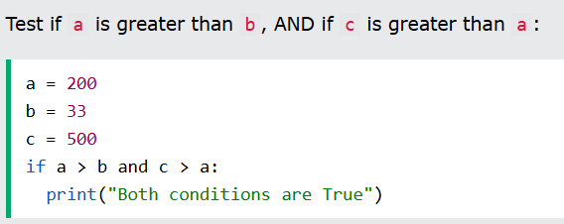
Ternary Operators, or Conditional Expressions.
Short Hand If ... Else
status = "Adult" if age >= 18 else "Minor"
And
The and keyword is a logical operator, and is used to combine conditional statements:

Slide 8
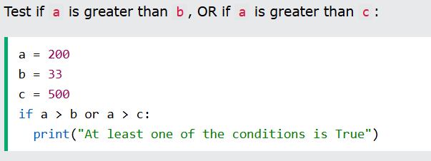
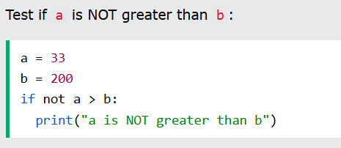
Or
The or keyword is a logical operator, and is used to combine conditional statements:
Not
The not keyword is a logical operator, and is used to reverse the result of the conditional statement:

Slide 9
Nested If
You can have if statements inside if statements, this is called nested if statements.
x = 41 if x > 10: print("Above ten,") if x > 20: print("and also above 20!") else: print("but not above 20.")
→Output:
Above ten, and also above 20!

Slide 10
The pass Statement
if statements cannot be empty, but if you for some reason have an if statement with no content, put in the pass statement to avoid getting an error.
a = 33 b = 200 if b > a: pass
# having an empty if statement like this, would raise an error without the pass statement

Slide 11
Python Match
Instead of switch(expression) we use Match in Python
The match statement is used to perform different actions based on different conditions.
Instead of writing many if..else statements, you can use the match statement.
The match statement selects one of many code blocks to be executed.

Slide 12
Syntax:
match expression: case x: code block case y: code block case z: code block
This is how it works: The match expression is evaluated once.
The value of the expression is compared with the values of each case.
If there is a match, the associated block of code is executed.

Slide 13
day = 4 match day: case 1: print("Monday") case 2: print("Tuesday") case 3: print("Wednesday") case 4: print("Thursday") case 5: print("Friday") case 6: print("Saturday") case 7: print("Sunday")

Slide 14
Default Value
Use the underscore character _ as the last case value if you want a code block to execute when there are not other matches:
day = 4 match day: case 6: print("Today is Saturday") case 7: print("Today is Sunday") case _: print("Looking forward to the Weekend")
→ Output : Looking forward to the Weekend

Slide 15
Combine Values
Use the pipe character | as an or operator in the case evaluation to check for more than one value match in one case:
day = 4 match day: case 1 | 2 | 3 | 4 | 5: print("Today is a weekday") case 6 | 7: print("I love weekends!")
→ Output : Today is a weekday

Slide 16
If Statements as Guards
You can add if statements in the case evaluation as an extra condition
month = 5 day = 4 match day: case 1 | 2 | 3 | 4 | 5 if month == 4: print("A weekday in April") case 1 | 2 | 3 | 4 | 5 if month == 5: print("A weekday in May") case _: print("No match")
→ Output : A weekday in May

Slide 17
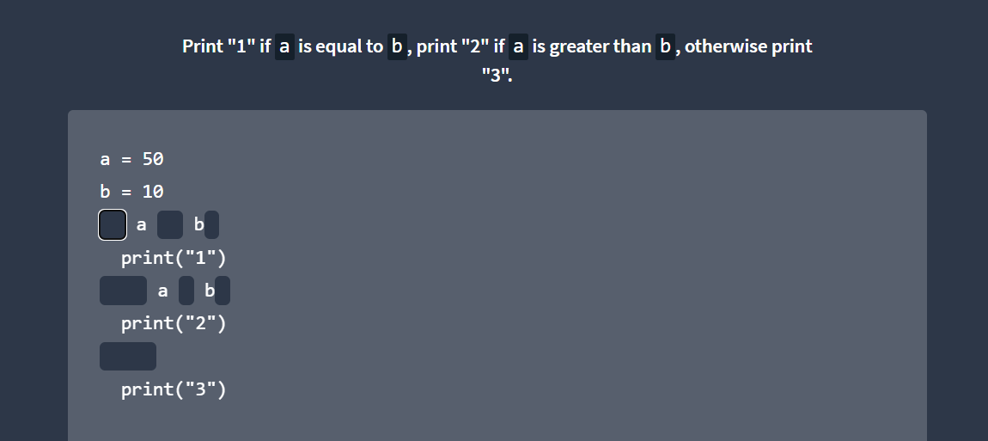
Q

Slide 18
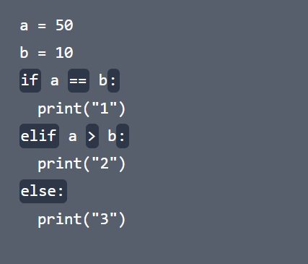
A

